Slide 1
TEAM 1
TEAM MEMBERS –
1. Sai Teja Malladi (Project Manager)
2. Jahid Hassan (Project Owner)
3. Bhakti Palkar (Lead Business Analyst)
4. Tahera Shaikh (Lead Developer)
5. Nidhi Berde (Software Developer)
6. Rushda Manusri (QA Analyst)
7. Amala Natu (Software Tester)
8. Sai Manish Avasarala (Database Administrator)
MaidEase

Slide 2
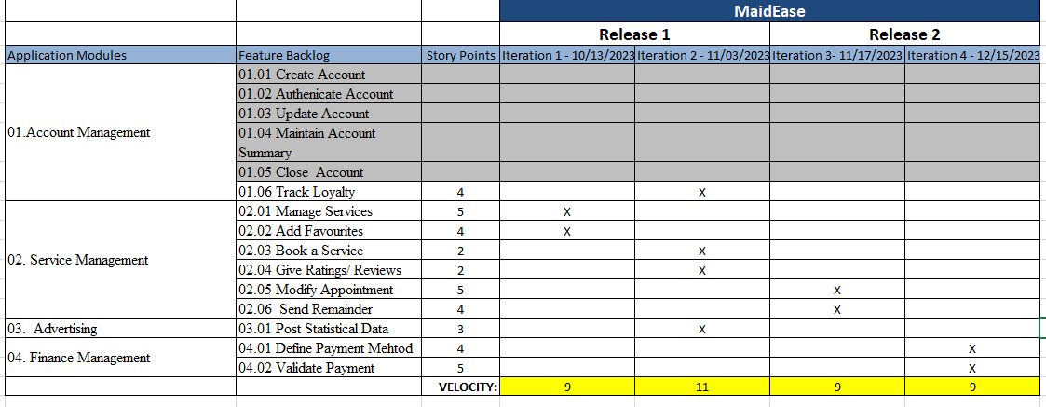
Road Map

Slide 3
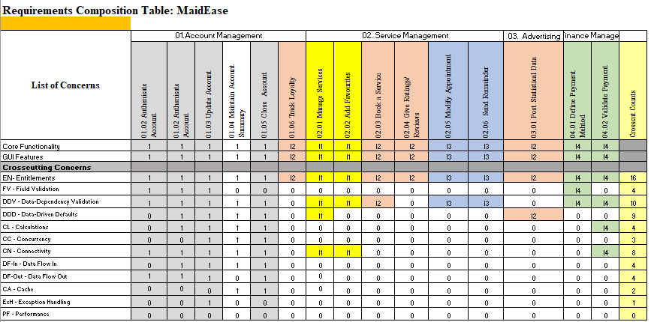
RCT (CORE + CROSSCUT)

Slide 4
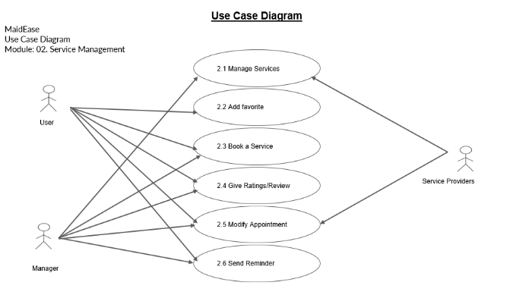
USE CASE DIAGRAMS

Slide 5
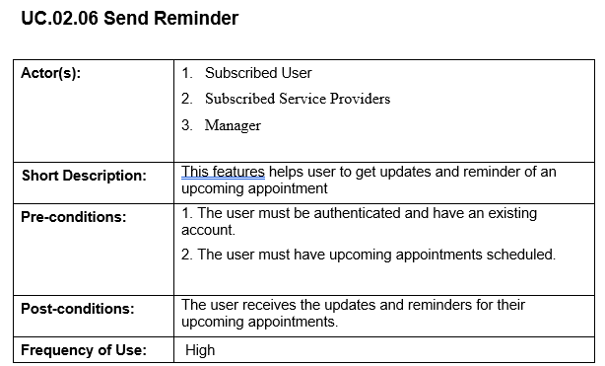
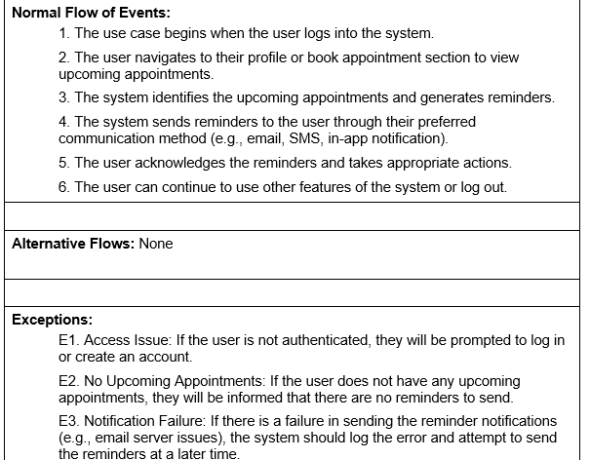
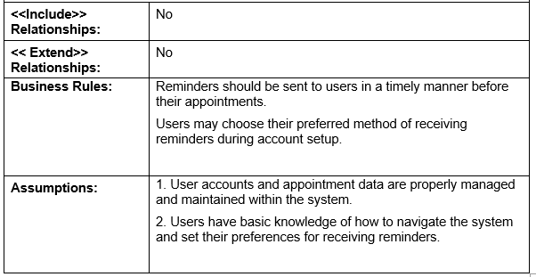
Use Case Specification

Slide 6
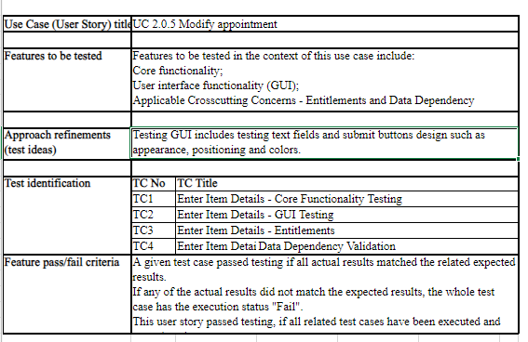
TEST DESIGN AND TEST CASES

Slide 7
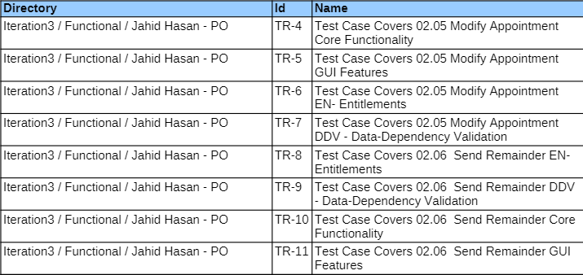
Test Execution Log

Slide 8
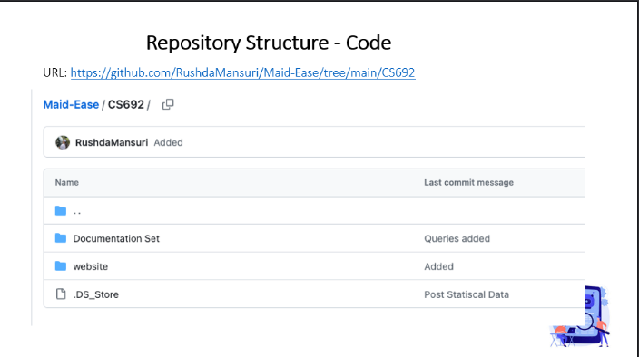
GITHUB POWERPOINT

Slide 9
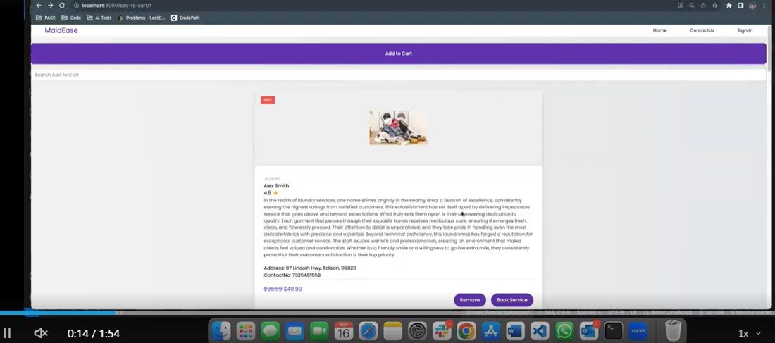
APPLICATION DEMO

